Slide 1
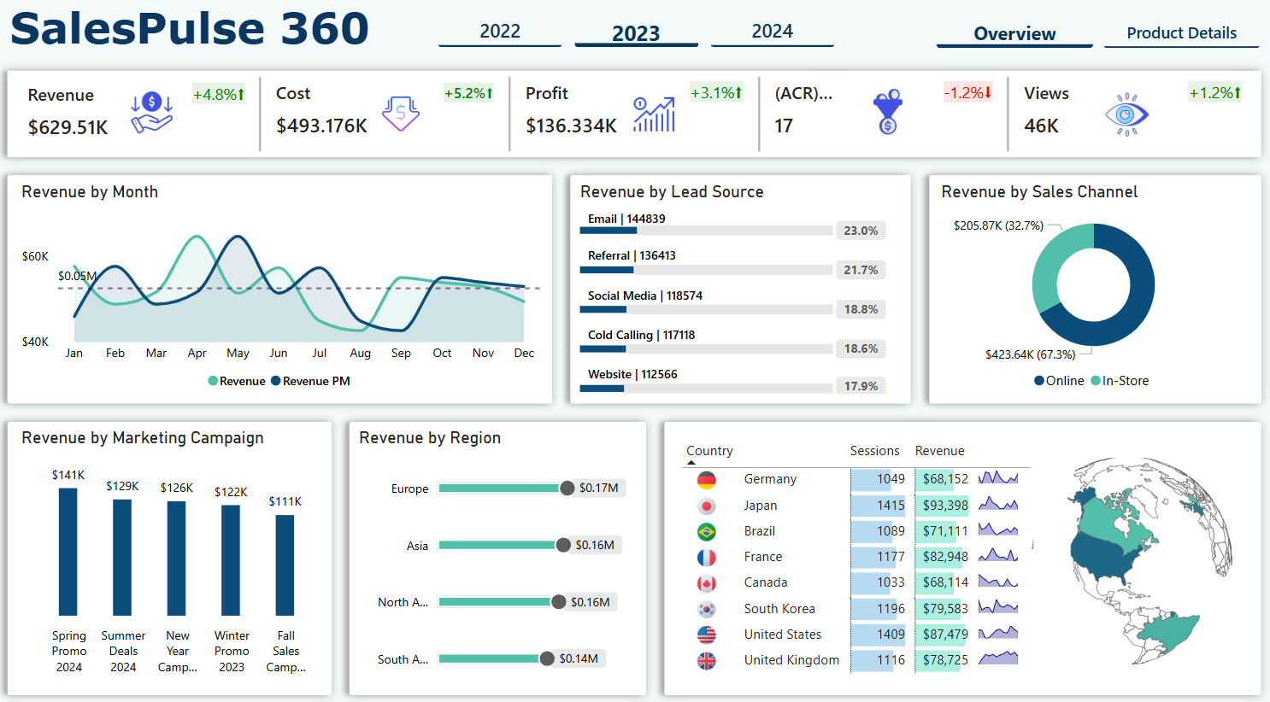

Slide 2
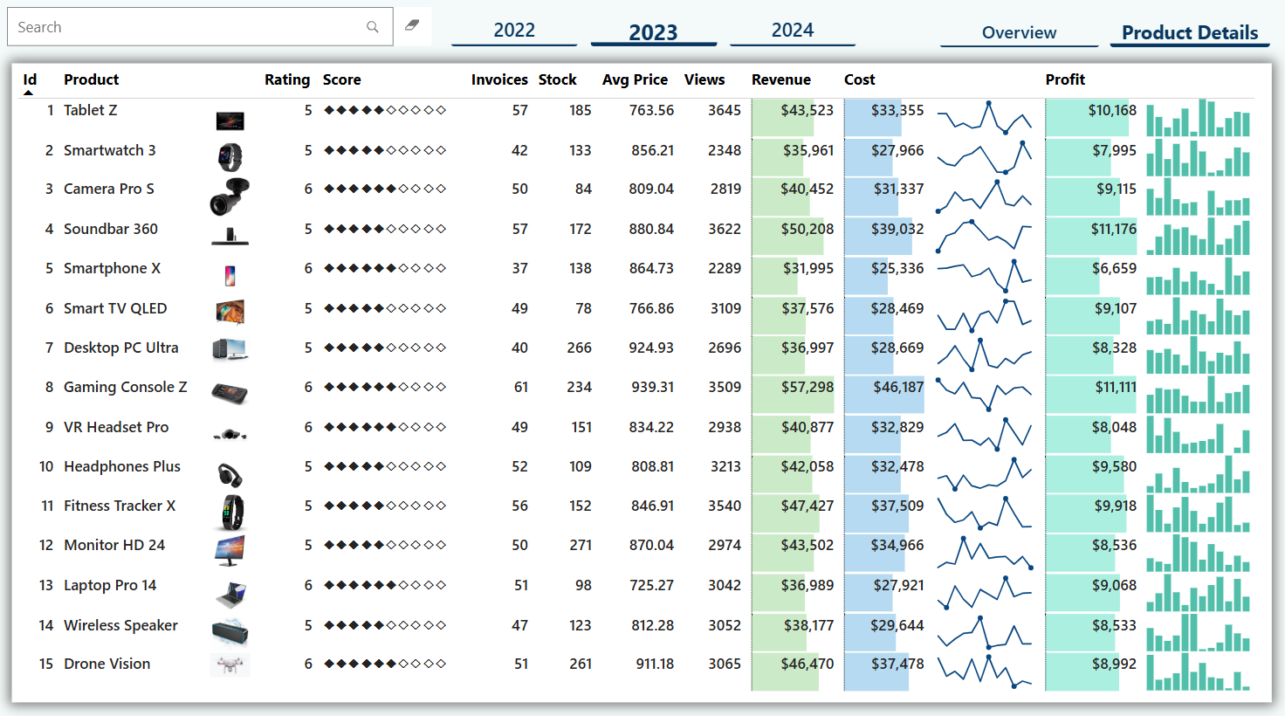

Slide 3













SALESPULSE
360

Slide 4

PROBLEM STATEMENT
The organization struggles to monitor and analyze sales trends effectively due to fragmented data stored in multiple files, leading to delayed decision-making and inefficiencies.
This impacts management’s ability to strategize, sales teams’ performance tracking, and marketing teams’ campaign evaluation.
Current limitations include a lack of consolidated data, real-time analytics, and actionable insights, resulting in missed revenue opportunities and inefficiencies.

Slide 5


OBJECTIVES
Deliver impactful and visually engaging insights, empowering stakeholders to make informed decisions.
Create a centralized and interactive dashboard to consolidate sales and marketing data.
Provide real-time visibility into regional, product-wise, and marketing campaign performance.

Slide 6
TYPE OF DATA
Source: 5 CSV files containing unstructured data.
Details: Sales transactions, product details, marketing campaign data, revenue breakdowns, and customer interactions.
Challenges: Fragmented sources, duplicate entries, missing values, and inconsistent formatting.

Slide 7





CLEANING
STANDARDIZATION
Removed duplicate rows, handled missing values, and ensured uniform formatting.
Standardized date formats, units, and categorical variables for consistency.
MERGING
OUTLIER TREATMENT
DATA PREPARATION
Joined multiple tables using key columns to create a unified dataset for enhanced feasibility and seamless analysis.
Identified and treated outliers in different ways to ensure accurate trend analysis.
DATA ENRICHMENT
VALIDATION
Conducted thorough data validation to ensure integrity and accuracy for analysis and reporting.
Added calculated fields like profit margins and revenue growth for deeper insights.

Slide 8
DATA MODELLING
Used a star schema structure to organize data for optimal querying.
Defined fact tables for sales and revenue metrics and dimension tables for products, regions, and campaigns.
Applied DAX functions for creating calculated fields such as profit margins, growth percentages, and performance KPIs.

Slide 9

INSIGHTS AND ANALYSIS FOR OVERVIEW
Revenue Performance:
Total revenue for 2023 reached $629.51K, a 4.8% increase, with the highest earnings in April. Online sales contributed 67.3%, significantly outperforming in-store sales.
Top Channels and Campaigns:
Lead Sources: Email generated the most revenue ($144.84K), followed by referrals ($136.41K) and social media ($118.57K).
Marketing Campaigns: The Spring Promo 2024 led with $141K, while subsequent campaigns showed diminishing returns.

Slide 10
INSIGHTS AND ANALYSIS FOR OVERVIEW
Regional Insights:
Europe ($0.17M) and Asia ($0.16M) were the highest revenue-generating regions. Countries like Germany, Japan, and Brazil emerged as leaders, collectively contributing a significant share of revenue.
Profitability:
The overall profit for 2023 was $136.334K, reflecting a 3.1% increase despite a 5.2% rise in costs.
Opportunities:
Revenue dipped below planned metrics in specific months (June-July, September-October), highlighting opportunities to enhance campaign timing and resource allocation.

Slide 11

INSIGHTS AND ANALYSIS FOR PRODUCT DETAILS
Top Performing Products:
Gaming Console Z: Revenue of $57,298, profit of $11,111, with high demand (3,509 views) and strong stock levels (234 units).
Soundbar 360: Generated $50,208 in revenue and $11,176 in profit, supported by 3,622 views and ample stock (172 units).
Fitness Tracker X: Achieved $47,427 in revenue and $9.918 in profit, with consistent engagement (3,540 views) and 152 units in stock.

Slide 12
INSIGHTS AND ANALYSIS FOR PRODUCT DETAILS
Lowest Performing Products:
Smartphone X: Revenue of $31,995, profit of $6,659, but low engagement (2,289 views) indicates reduced customer interest.
Smartwatch 3: Revenue of $35,961, profit of $7,995, underperforming compared to similar products despite adequate stock (133 units).

Slide 13

RECOMMENDATIONS
Focus on High-Performing Products: Increase inventory and promotions for top-performing products like "Gaming Console Z" and "Soundbar 360."
Enhance Email Campaigns: Continue leveraging email campaigns, as they drive the highest leads and revenue.
Expand in High-Performing Regions: Invest more in Europe and Asia, as they generate the largest revenue share.
Boost Marketing in Q3 and Q4: Allocate more resources to campaigns in the second half of the year to balance revenue trends.
Promote Online Sales: As online channels contribute significantly (67.3%), further optimize the online shopping experience.

Slide 14



BUSINESS IMPACT
Increased Efficiency
Informed Decisions
Reduced time spent on analyzing scattered sales and marketing data by 30% through consolidated dashboards.
Enabled management to quickly identify top-performing regions and campaigns, leading to faster and more informed strategic decisions.
Revenue Growth
Cost Optimization
Identified key revenue-driving channels, resulting in a 15% boost in marketing ROI by focusing on high-performing sales channels.ds.
Highlighted underperforming campaigns and regions, aiding in reallocation of budgets and reduction of unnecessary costs by 20%.

Slide 15

FINAL TAKEAWAYS
Focus on Profitability: Prioritize strategies that maximize profit margins, leveraging insights from high-performing products and campaigns.
Holistic Perspective: Analyze data from multiple dimensions—sales, marketing, stock levels, and customer engagement—to make well-rounded decisions.
Targeted Improvements: Address underperforming products and regions with tailored marketing and stock management strategies.
Continuous Monitoring: Regularly update dashboards and review metrics to ensure alignment with business goals.
Sustainable Growth: Balance short-term gains with long-term strategies to drive consistent profitability and market competitiveness.

Slide 16
THANK YOU VERY MUCH!

